Slide 1
Protein Pow(d)er
Programmeertheorie, Week 2, Presenteersessie 1
Team: Shire Peasants 3
Authors: Mark Dzoljic, Loek van Steijn, Sebastiaan Kruize

Slide 2
Format of the presentation
1. Introduction in the casus
State Space of the problem (Mark)
2. Datastructures (Terugblik vorige week) (Loek)
Dictionairy vs. Matrix
Results
3. Algorithms (Sebas)
Random, Greedy
4. Results (Sebas)
Future heuristieken (Allemaal)
5. Q&A and discussion (Mark)

Slide 3
1. Introduction: Stability of proteins
Proteins fulfill numerous function inside the human body
Faulty proteins linked to diseases such as Alzheimers or huntington

Slide 4
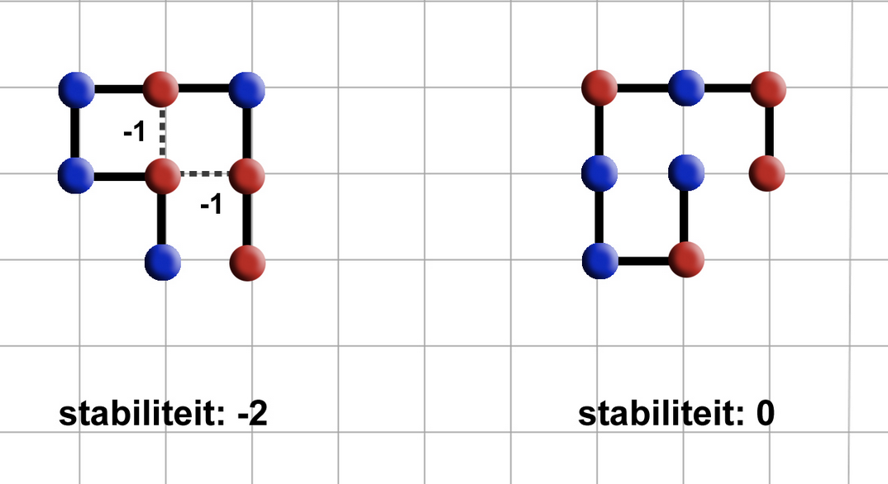
1. Introduction: Stability of proteins
As more hydrophobic amino-acids (red) are next to each other, the more stable it is
Stability of 0 means unstable
Stability of -2 means more stable.
Goal is to find protein structures that are as stable as possible.

Slide 5
1. Heuristics of Protein Pow(d)er
Constrained Optimization Problem
Constraints
Amino-acid string is given
All amino-acids must be used
Amino-acids cannot overlap
Optimization
Legitimate solution with the highest

Slide 6
1. State Space en upper/lower bounds
Statespace
→ 4^{n-1}
Amino acids cannot overlap
→ 4*3^{n}
→ 3^{n-2}
Upperbound: 3x
Met x is aantal H-elements
Lowerbound: > 0

Slide 7
2. Datastructures
Dictionaries
Use dictionaries to store elements with coordinates. Bind them with a direction variable
Matrixes
Use of a matrix object to store elements.

Slide 8
3. Algorithms
Suboptimal results:
Random
Greedy
Optimal results
Linear algorithm

Slide 9
4. Method: Possible algorithms
Name | Result | Method | Ω (Best Case) | Runtime (1000 iterations) Dict | Runtime (1000 iterations) Matrix
Random | Sub-optimal | Constructive
Greedy | Sub-optimal+ | Constructive
Lineair | Optimal | Constructive
Future | - | -

Slide 10
Future:
Welke heuristieken gaan we komende week aan werken.

Slide 11
Questions and comments?
Our questions:
All our algorithms are ‘constructive’. Ideas where to think regarding iterative algorithms?
What is your view on our choice for datastructure?
Thank you for your attention

